Slide 1
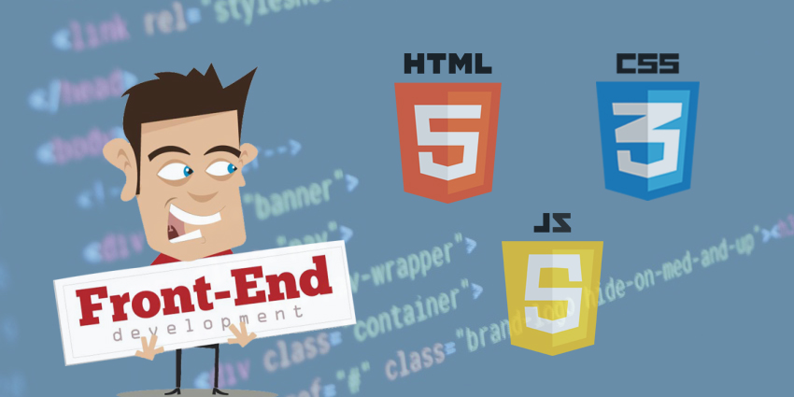
Front End Developer Training
Level 1
Submitted By
AJEESH K.GEORGE

Slide 2
FRONT END WEB DEVELOPMENT
Front-end Web development is Everything involved in Programming the user interface of a web application
Creating a graphical interface (front end) for the user to view and interact with data.
The tools used for front-end development are,
1. HTML(Hypertext Markup Language)-Markup language for creating web pages, contents, the building block and basic structure.
2. CSS(Cascading Style Sheets)-Describes the pages appearance/presentation.
3. JavaScript-Programs the behavior of the webpage.

Slide 3
MDN WEB DOCS
MDN Web Docs, previously known as Mozilla Developer Network.
Community-By the Developers, For the Developers, Of the Developers.
MDN provide access to the best documentation, Tutorials, References and developer tools available.
Contain HTML, CSS, JS, Web APIs, other development and debugging tools.

Slide 4
DEVELOPER UTILITIES
BROWSER CONSOLE:
Debugging tool for developers, browser integrated.
Logs information on network requests, js, warnings, messages logged by js code, http requests.
Panels:Elements, Console, Sources, Network, Performance, Memory,Security.

Slide 5
JS FIDDLE
Online Community for testing and showcasing user created html, css, js codes.
Supports Libraries, Frameworks, Tidy up, JSHint.
The code snippets are called as fiddles.
Bookmark, collaborate and share your fiddles.

Slide 6
JS BIN
Enable you to
Learn
Experiment
Remote Teaching
Hack
Live Preview.
Snippets are called bins.

Slide 7
CODEPEN
Utility and Social Network of Front End Developers and Designers.
Online Community for testing and showcasing user created HTML,CSS and Javascript code snippets.
No proper version tracking and non-collaborative.

Slide 8
PLUNKER
Multiple files inside the plunk.
Versioning
Integrated Web development environment.
Provide us to write plunks and share it with other users.

Slide 9
What is HTML?
HTML stands for Hyper Text Markup Language
HTML describes the structure of Web pages using markup
HTML elements are the building blocks of HTML pages
HTML elements are represented by tags

Slide 10
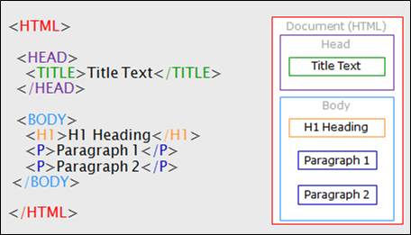
HTML Structure

Slide 11
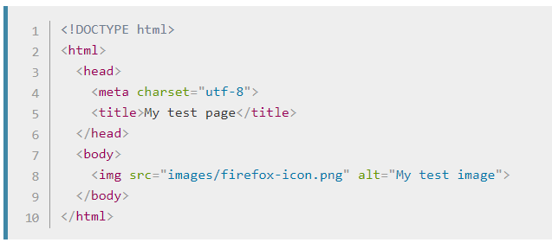

Slide 12
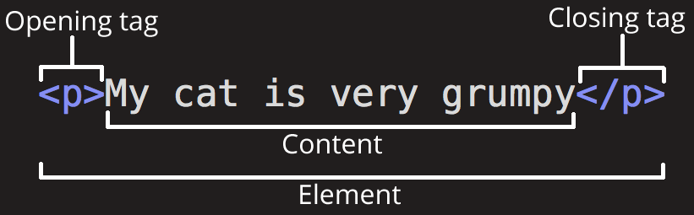
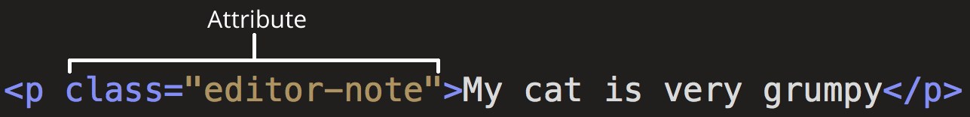
HTML TAGS
Usual HTML Elements: <tag name> content </tag names>.
Tags can have Name, Attributes and Values.

Slide 13
Main Root : <html>.
Document Metadata: <link>, <meta>, <style>, <title>, <script>
Sectioning root: <body>.
Content Sectioning- Logical organisation of Document: Semantic&Header tags.

Slide 14
Text Content- Organize blocks of content: <div>, lists(<ol>, <ul>, <dl>), <p> .
Inline text semantics-applicable to an arbitrary piece of text: <span>,<strong>,<a>.
Image & Multimedia.
Embedded content(<embed>, iframe- Inline frame element; embeds another html page to the current page).
Table and Form

Slide 15
HTML FORMS
<form>….</form>
<input>, Types( text, number, password, file, submit,reset,radio,checkbox,email,button...)
Attributes(name, value, read-only, disabled, placeholder, max, min…)
<select> Drop-down
<textarea>
Datalist and Output.

Slide 16
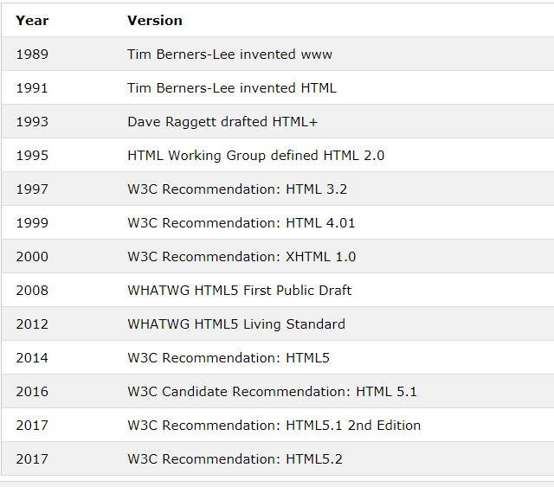
HTML History

Slide 17

W3C
The World Wide Web Consortium (W3C) is an international community founded in 1994 to develop Web standards.

Slide 18
HTML 5
Initial Release in 2014 by World Wide Web Consortium .
Encouraging Semantic (Meaningful) Markup.
Separating Design from Content.
Promoting accessibility and design responsiveness.
Reducing the overlap between html, css, js.
Supporting rich media experiences.

Slide 19
HTML 5 NEWBIES
Simple <!doctype html>
Custom elements, with the help of css and js (html5shiv)
HTML 5 Semantic Elements (header, footer, article, section, nav, aside, figure, main, bdi)
Content editable.

Slide 20
New input types that are introduced in HTML5
color
date
datetime-local
email
month
number
range
search
tel
time
url
week

Slide 21
MULTIMEDIA
IMAGES
<figure> and <figurecaption> (HTML 5 only)
<picture> for responsive images
Image maps- with clickable link area.
<img src="wrongname.gif" alt="Flowers in Chania">

Slide 22
VIDEO
<video>,<source>, <type>, <track>
Attributes: Height, width, controls, autoplay, preload, muted, loop.
Use <iframe> to embed Youtube content.
<video width="320" height="240" controls>
<source src="movie.mp4" type="video/mp4">
<source src="movie.ogg" type="video/ogg">
Your browser does not support the video tag.
</video>

Slide 23
AUDIO
<audio> <source> <type> <track>
Attributes: autoplay, preload, muted, loop.
<audio controls>
<source src="horse.ogg" type="audio/ogg">
<source src="horse.mp3" type="audio/mpeg">
Your browser does not support the audio element.
</audio>

Slide 24
CANVAS
Used to draw graphics on a web page, with the help of js and produce Raster images.
The <canvas> element is only a container for graphics. You must use JavaScript to actually draw the graphics.
<canvas id="myCanvas" width=" 200" height="100" style="border:1px solid #d3d3d3;"> </canvas>
<script>
var c = document.getElementById("myCanvas");
var ctx = c.getContext("2d");
ctx.moveTo(0,0);
ctx.lineTo(200,100);
ctx.stroke();
</script>

Slide 25
SVG(Scalable Vector Graphics)
Text based Language for Describing 2D Graphics in XML.
SVG is used to define graphics for the Web.
Produce Vector Images.
<svg width="400" height="100">
<rect width="400" height="100"
style="fill:rgb(0,0,255);stroke-width:10;stroke:rgb(0,0,0)" />
</svg>

Slide 26
CROSS BROWSER HTML
Your code must run in various browsers, new, old or un-heard.
Coding practices, validators, cross browser testing, browser detection can help.
A linter avoids coding practices causing compatibility issues; cssLint, JSHint, Dirty Markup.
Sripts and frameworks(respond.js, modernizr) can solve issues.

Slide 27
Thank You

